Slide 1


- Lecture Two -

Slide 2

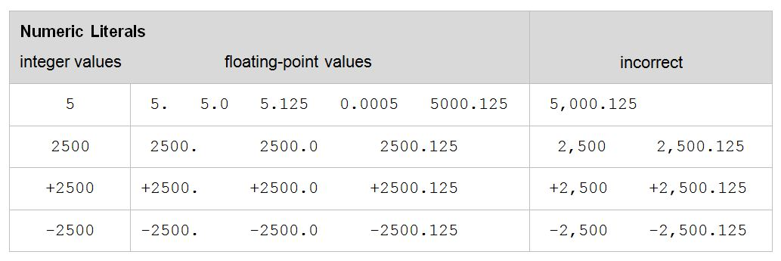
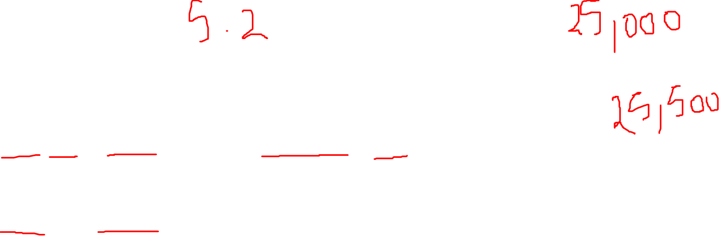
Float Numbers

Slide 3
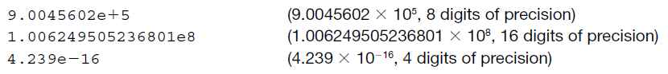
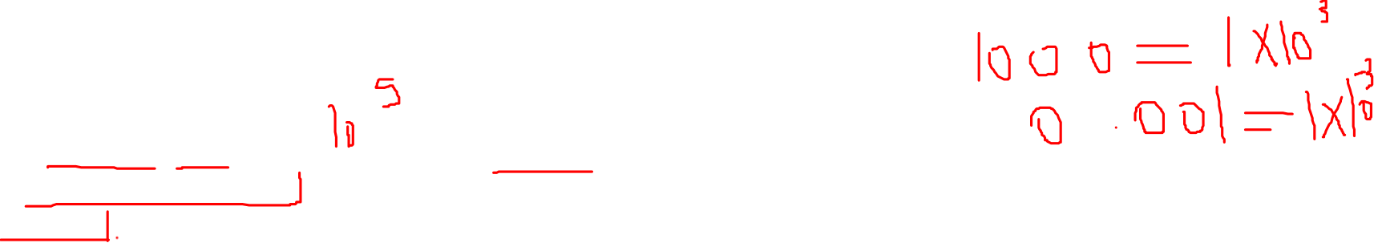
precisions
There is no limit to the size of an integer that can be represented in Python. Floating point values, however, have both a limited range and a limited precision.
Python uses a double-precision standard format (IEEE 754) providing a range of 10⁻³⁰⁸ to 10³⁰⁸ with 16 to 17 digits of precision. To denote such a range of values, floating-points can be represented in scientific notation,
1 gram = 1* (10^-3) Kilo gram

Slide 4
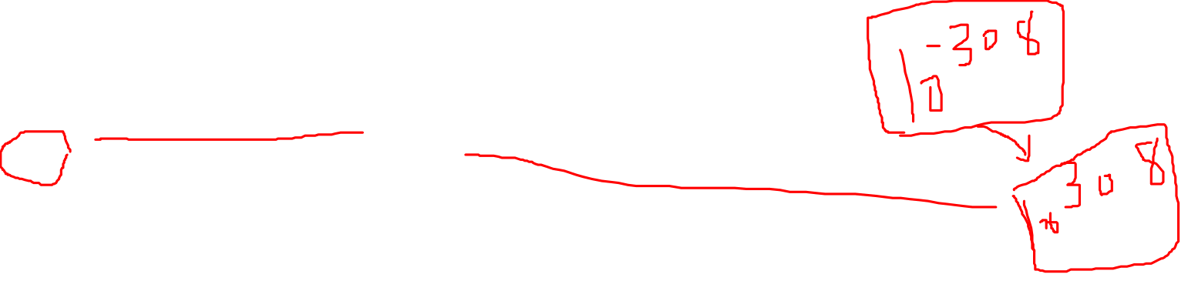
arithmetic overflow
It is important to understand the limitations of floating-point representation. For example, the multiplication of two values may result in arithmetic overflow, a condition that occurs when a calculated result is too large in magnitude (size) to be represented,
>>> 1.5e200 * 2.0e210
inf
This results in the special value inf (“infinity”) rather than the arithmetically correct result 3.0e410, indicating that arithmetic overflow has occurred.

Slide 5
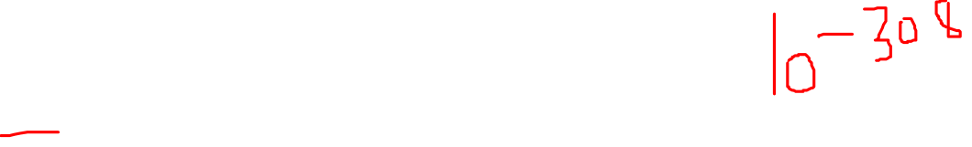
arithmetic Underflow
Similarly, the division of two numbers may result in arithmetic underflow, a condition that occurs when a calculated result is too small in magnitude to be represented,
>>> 1.0e-300 / 1.0e100
0.0
This results in 0.0 rather than the arithmetically correct result 1.0e-400, indicating that arithmetic underflow has occurred.

Slide 6
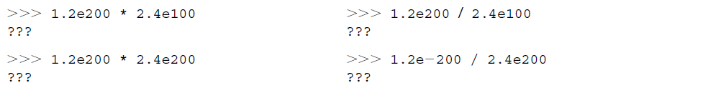
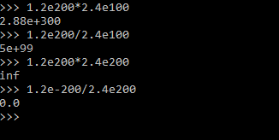
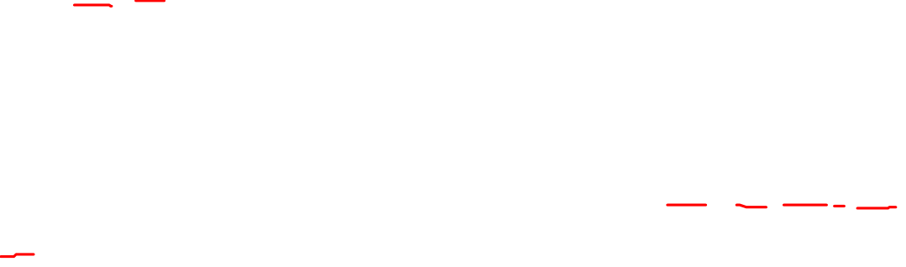
Exponents
1.2e200 = 1.2*(10^200)
1.2e-100 = 1.2*(10^-100)

Slide 7
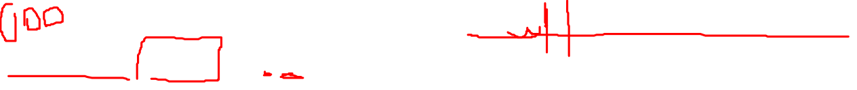
formatting
Because floating-point values may contain an arbitrary number of decimal places, the built-in format function can be used to produce a numeric string version of the value containing a specific number of decimal places,
>>> 12/5 >>> 5/7
2.4 0.7142857142857143
>>>format(12/5,'.2f') >>>format(5/7,'.2f')
'2.40' '0.71'
In these examples, format specifier '.2f' rounds the result to two decimal places of accuracy in the string produced.

Slide 8
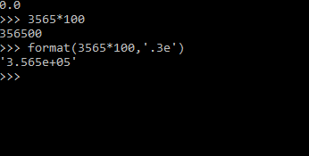
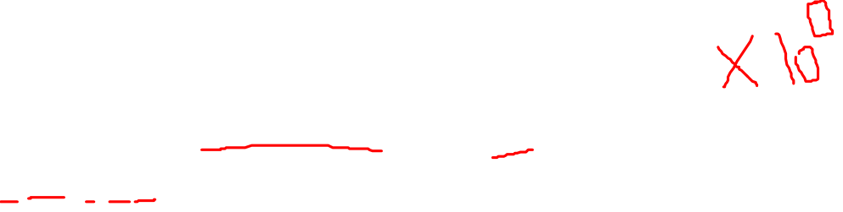
Formatting
For very large (or very small) values 'e' can be used as a format specifier,
>>> format(2 ** 100, '.6e')
'1.267651e+30'
Here, the value is formatted in scientific notation, with six decimal places of precision.

Slide 9
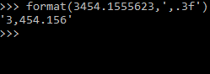
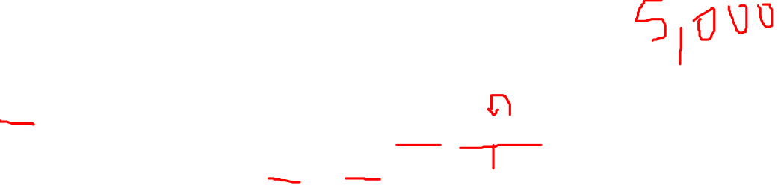
Formatting
Finally, a comma in the format specifier adds comma separators to the result,
>>> format(13402.25, ',.2f')
13,402.24

Slide 10
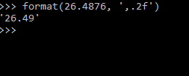
Formatting
Finally, a comma in the format specifier adds comma separators to the result,
>>> format(13402.25, ',.2f')
13,402.24
>>> format(26.4876, ',.2f')

Slide 11
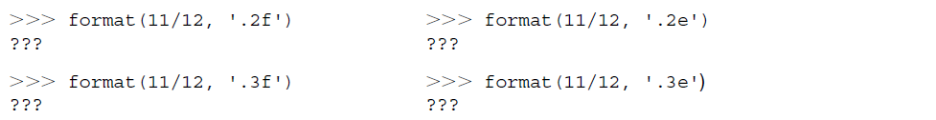
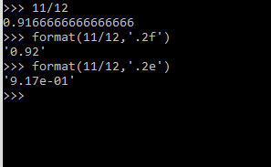
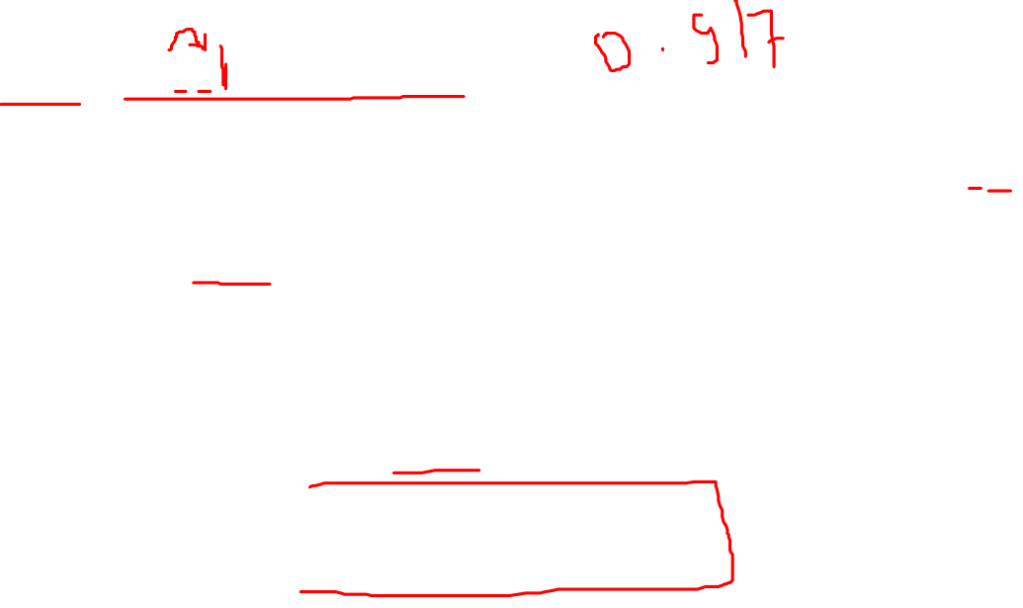
Formatting
11/12 = 0.9166666666666666

Slide 12
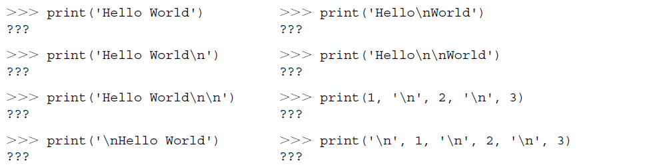
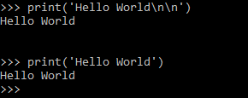
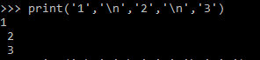
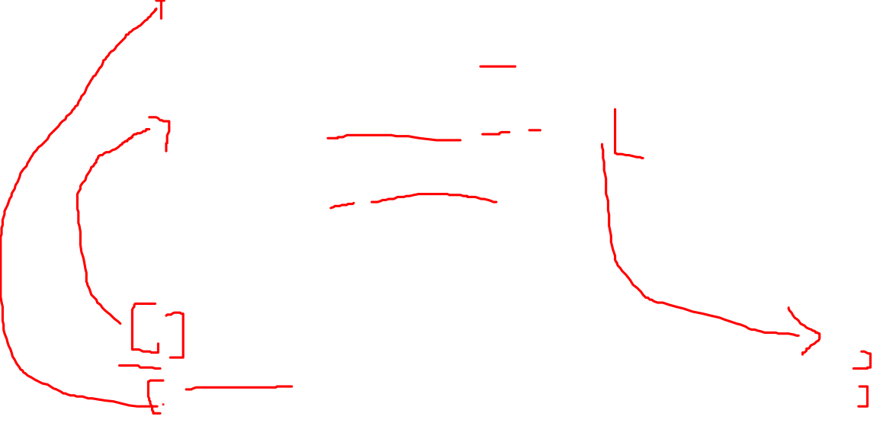
Strings

Slide 13
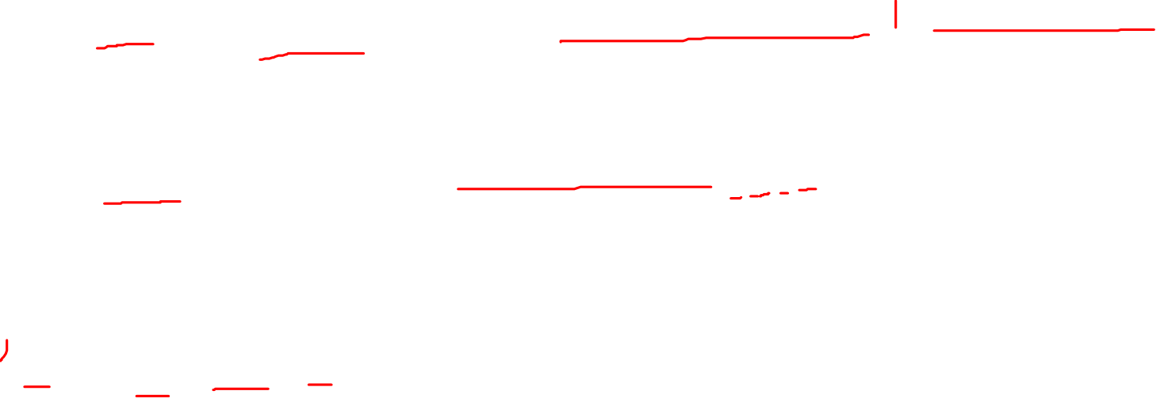
Formatting
For example, the following produces the string 'Hello' left-justified in a field width of 20 characters,
format('Hello', '< 20') ➝ 'Hello
To right-justify the string, the following would be used,
format('Hello', '> 20') ➝ ' Hello'
H
E
L
L
O

Slide 14
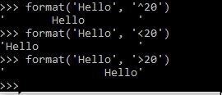
Formatting
Formatted strings are left-justified by default. Therefore, the following produce the same result,
format('Hello', '< 20') ➝ 'Hello '
format('Hello', '20') ➝ 'Hello '

Slide 15
Formatting
To center a string the '^' character is used:
format('Hello', '^20')
Another use of the format function is to create a string of blank characters, which is sometimes useful,
format(' ', '15') ➝ ' '

Slide 16
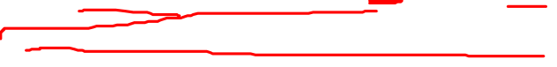
Formatting
Finally blanks, by default, are the fill character for formatted strings. However, a specific fill character can be specified as shown below,
>>> print('Hello', format('.', '.<30'), 'Have a Nice Day!')
Hello .............................. Have a Nice Day!
Here, a single period is the character printed within a field width of 30, therefore ultimately printing out 30 periods.

Slide 17
Formatting
Finally blanks, by default, are the fill character for formatted strings. However, a specific fill character can be specified as shown below,
>>> print('Hello', format('.', '.<30'), 'Have a Nice Day!')
Hello .............................. Have a Nice Day!
print('Hello', format('-','.<5'), 'world')

Slide 18
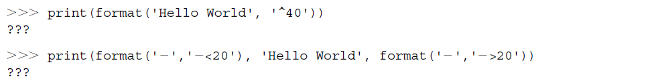
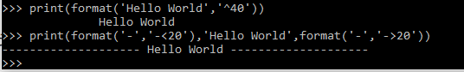
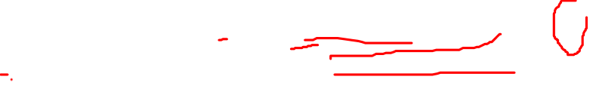
Formatting

Slide 19
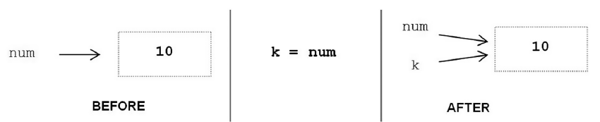
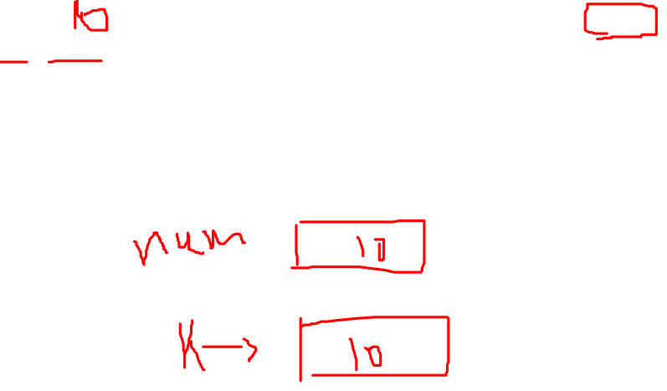
Alicing
Memory
0x00000
Num ->
10
0x00001
0x00002
K ->
20
0x00003
0x0004
Counter ->
60

Slide 20
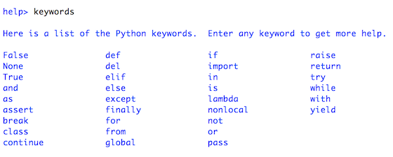
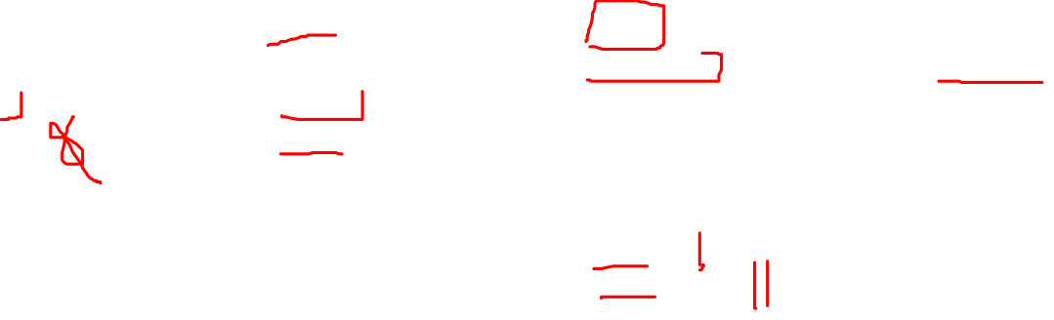
Key words

Slide 21
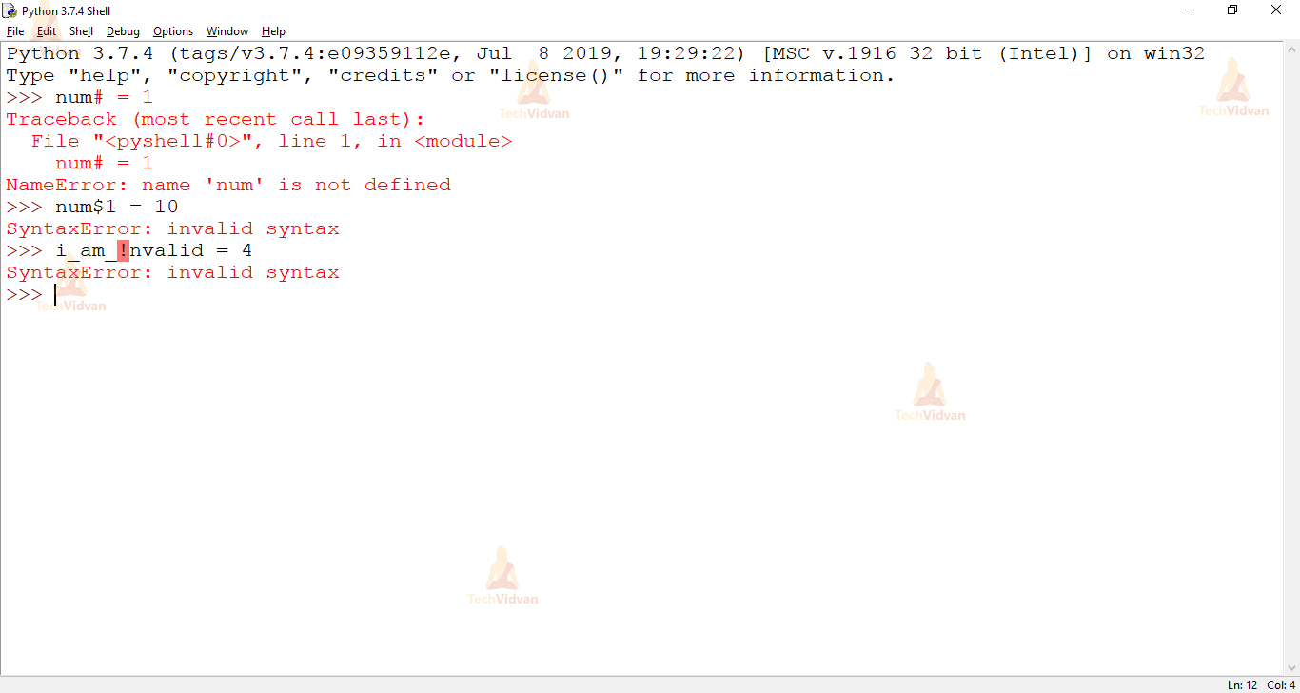
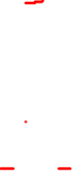
Variable Naming

Slide 22
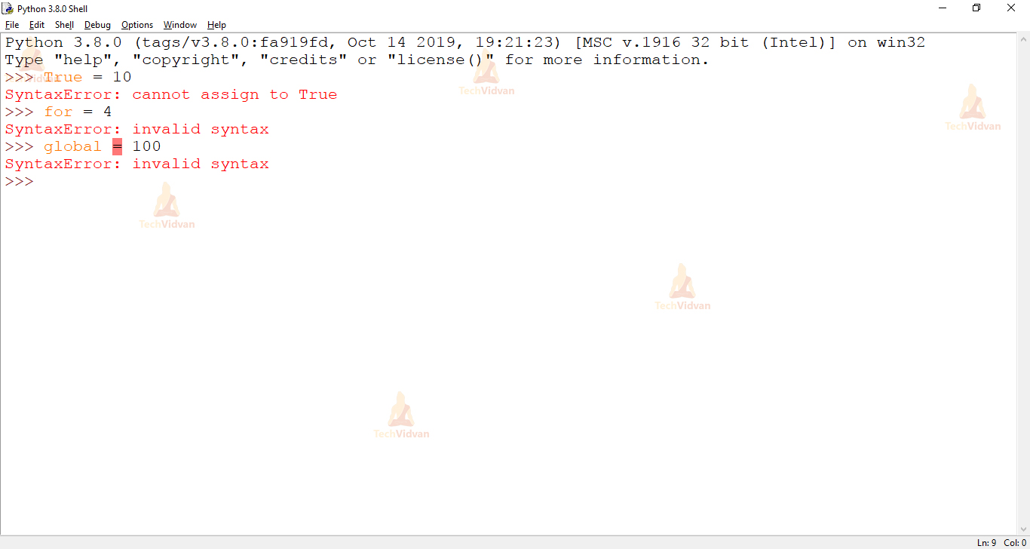
Variable Naming

Slide 23
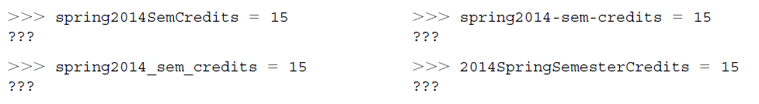
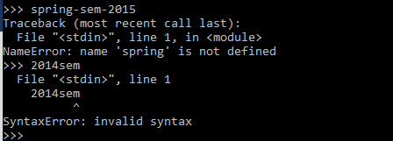
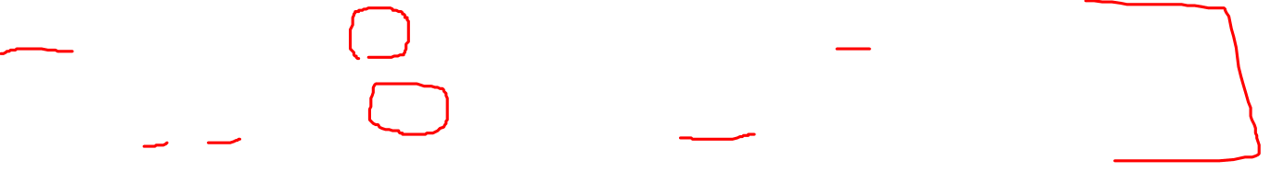
Variable Naming

Slide 24
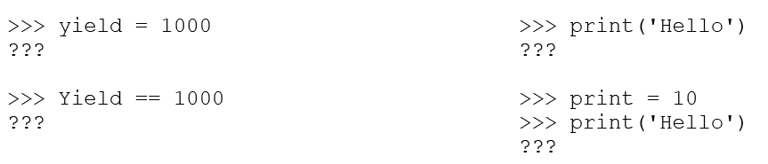
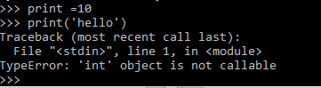
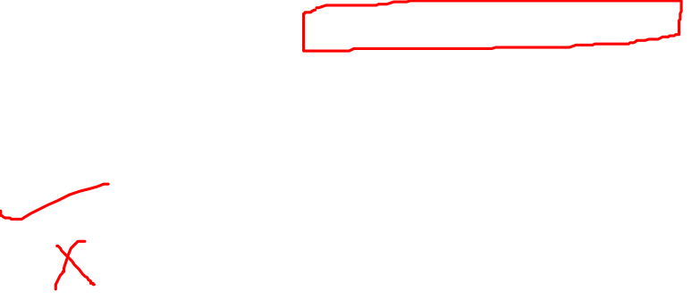
Keywords

Slide 25
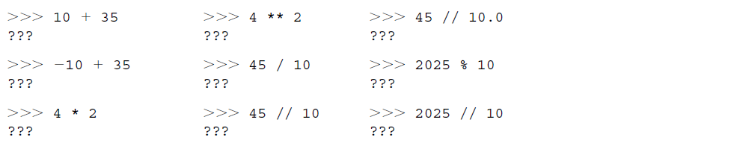
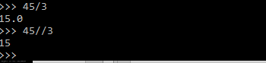
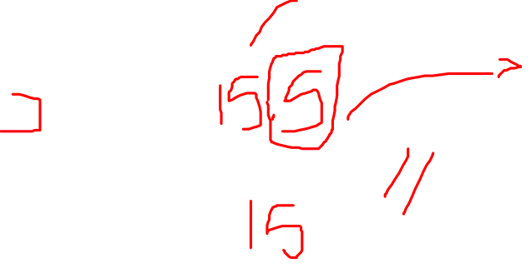
operations

Slide 26
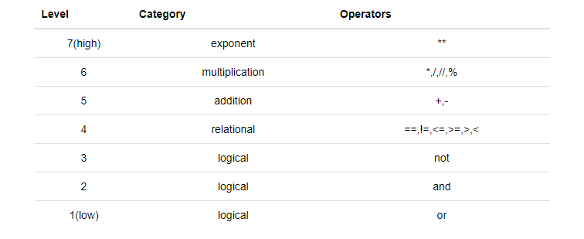
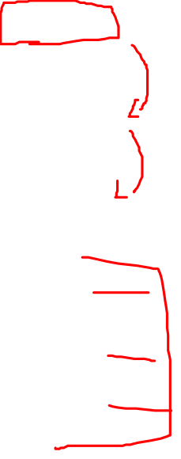
Arithmetic operations precedence

Slide 27
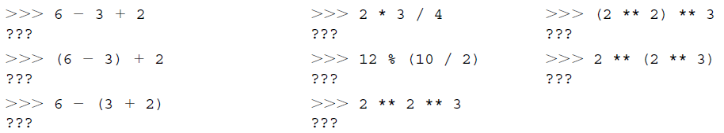
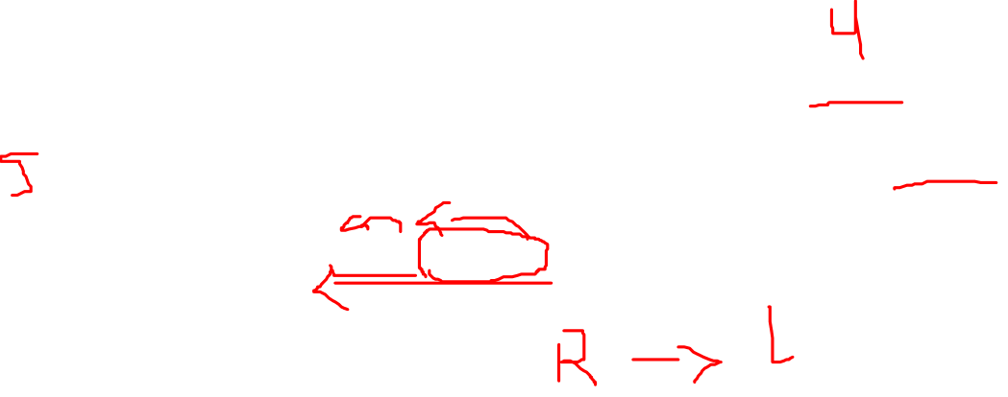
Arithmetic operations precedence

Slide 28
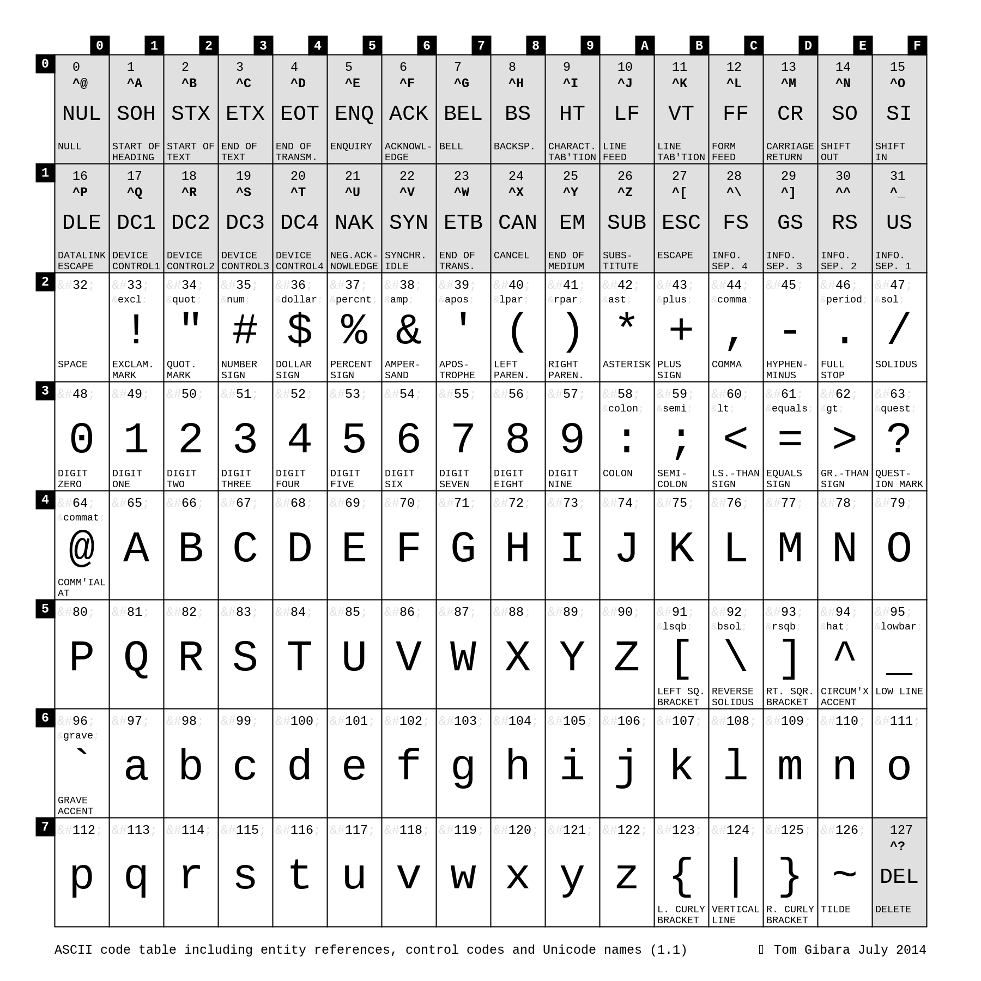
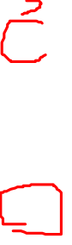
Strings are Arrays

Slide 29

The End
And that brings us to the end.
I’d like to thank you for your time and attention today.

